Slide 1
Fourier Series
主講者：虞台文

Slide 2
Content
Periodic Functions
Fourier Series
Complex Form of the Fourier Series
Impulse Train
Analysis of Periodic Waveforms
Half-Range Expansion
Least Mean-Square Error Approximation

Slide 3
Fourier Series
Periodic Functions

Slide 4
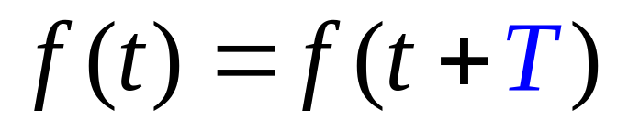
The Mathematic Formulation
Any function that satisfies
where T is a constant and is called the period of the function.

Slide 5
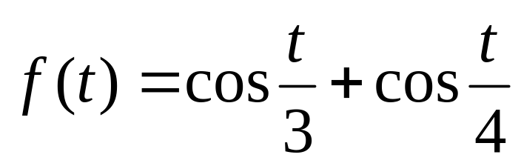
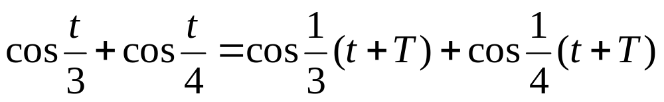


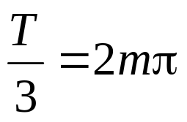


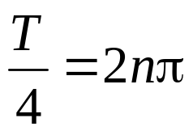

Example:
Find its period.
Fact:
smallest T

Slide 6
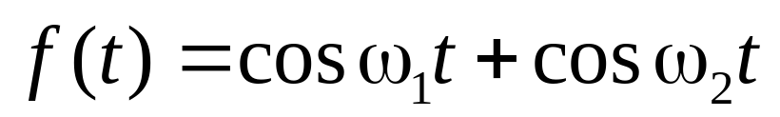

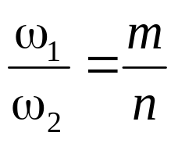
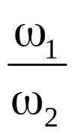

Example:
Find its period.
must be a rational number

Slide 7
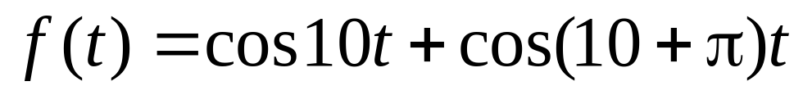
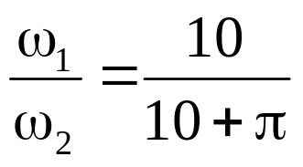
Example:
Is this function a periodic one?
not a rational number

Slide 8
Fourier Series
Fourier Series

Slide 9
Introduction
Decompose a periodic input signal into primitive periodic components.
A periodic sequence
f(t)
t
T
2T
3T

Slide 10
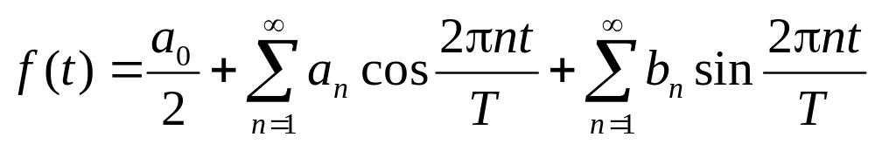
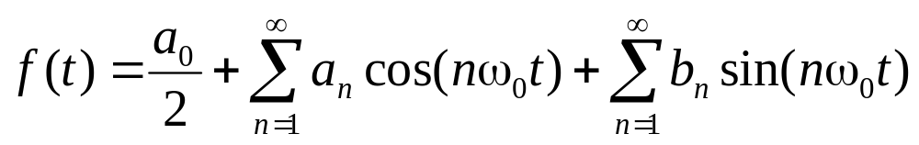
Synthesis
T is a period of all the above signals
Even Part
Odd Part
DC Part
Let ω₀=2π/T.

Slide 11
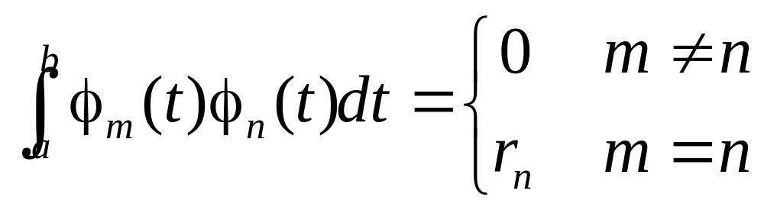
Orthogonal Functions
Call a set of functions {φ_{k}} orthogonal on an interval a < t < b if it satisfies

Slide 12
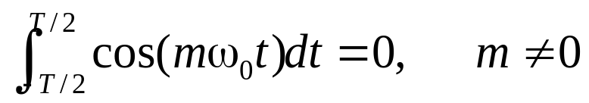
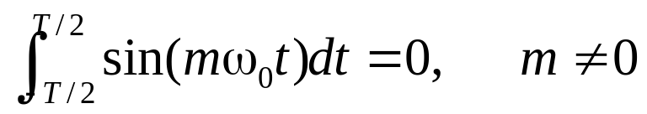
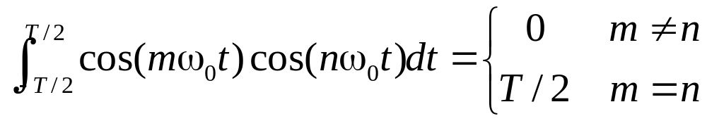
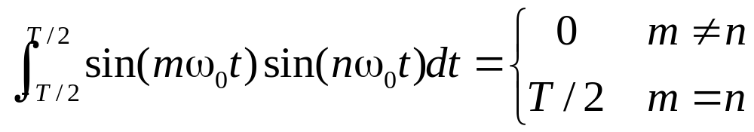
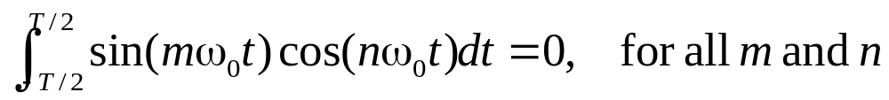
Orthogonal set of Sinusoidal Functions
Define ω₀=2π/T.
We now prove this one

Slide 13
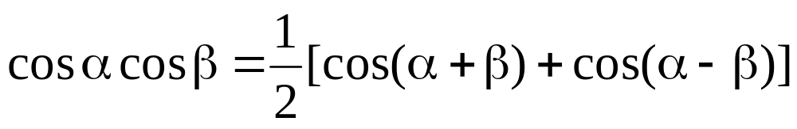
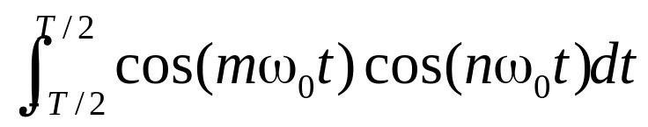
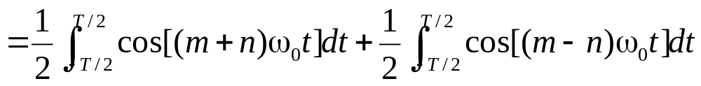
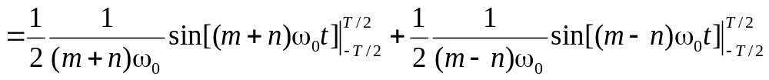
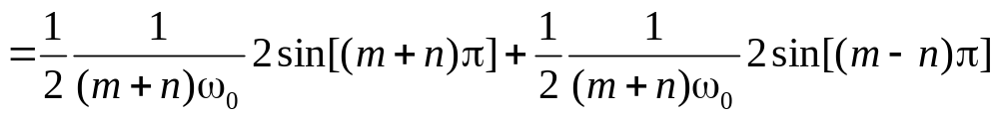
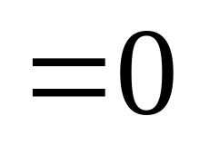
Proof
m ≠ n
0
0

Slide 14
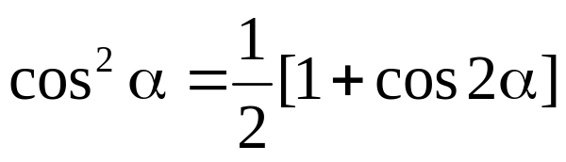
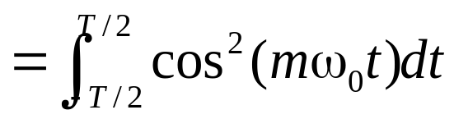
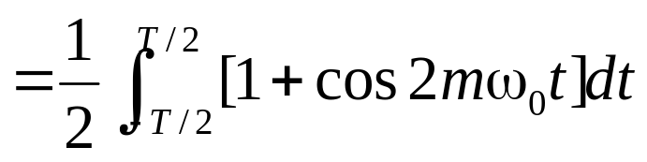
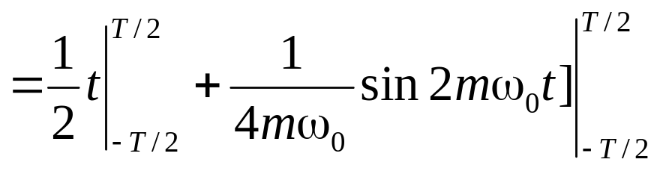
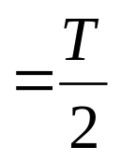
Proof
m = n
0

Slide 15
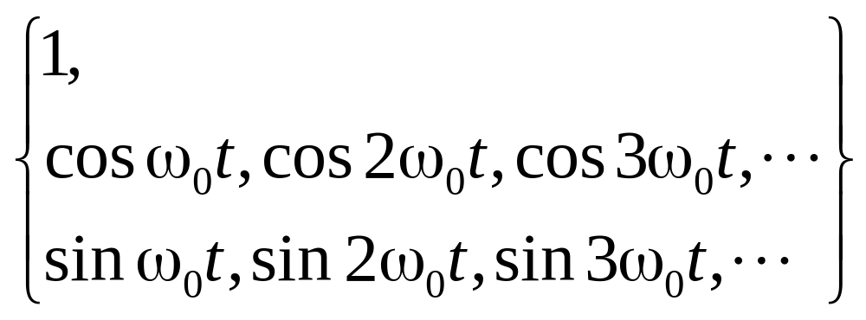
Orthogonal set of Sinusoidal Functions
Define ω₀=2π/T.
an orthogonal set.

Slide 16
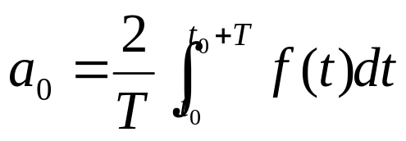
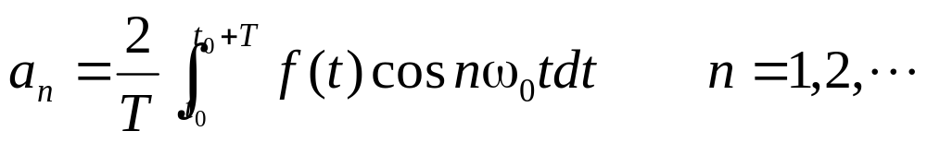
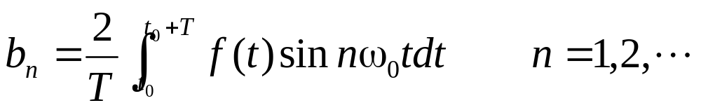
Decomposition

Slide 17
Proof
Use the following facts:

Slide 18
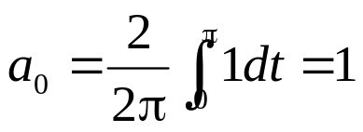
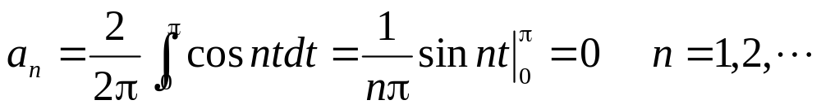
Example (Square Wave)
f(t)
1
-6π
-5π
-4π
-3π
-2π
-π
π
2π
3π
4π
5π

Slide 19
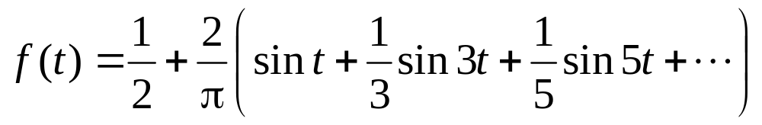
Example (Square Wave)
f(t)
1
-6π
-5π
-4π
-3π
-2π
-π
π
2π
3π
4π
5π

Slide 20
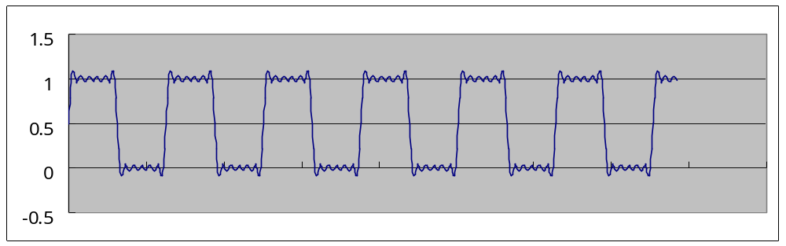
Example (Square Wave)
f(t)
1
-6π
-5π
-4π
-3π
-2π
-π
π
2π
3π
4π
5π

Slide 21
Harmonics
T is a period of all the above signals
Even Part
Odd Part
DC Part

Slide 22
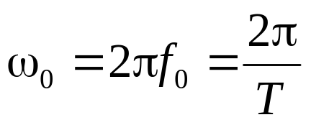
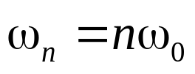
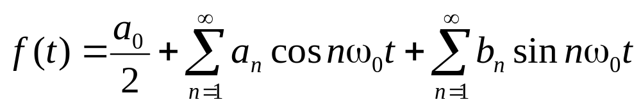
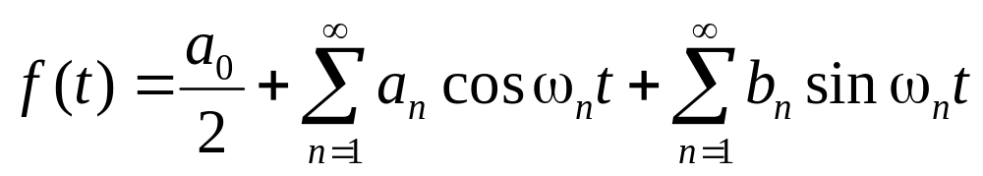
Harmonics
Define , called the fundamental angular frequency.
Define , called the n-th harmonic of the periodic function.

Slide 23
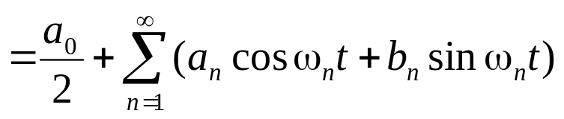
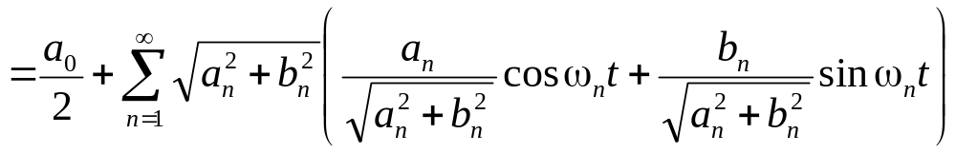
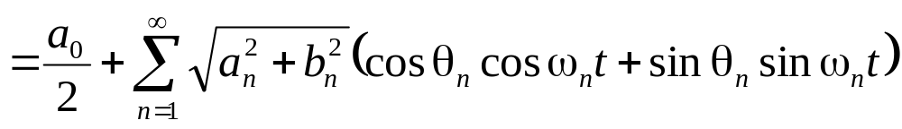
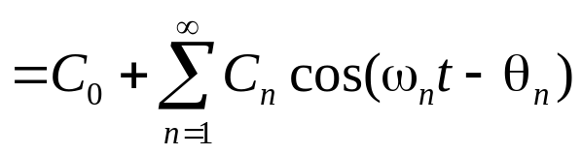
Harmonics

Slide 24
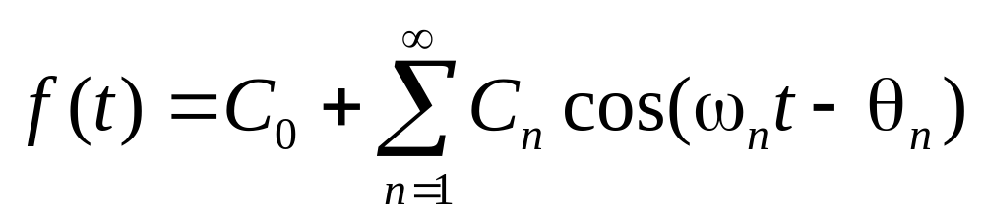
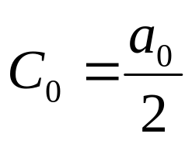
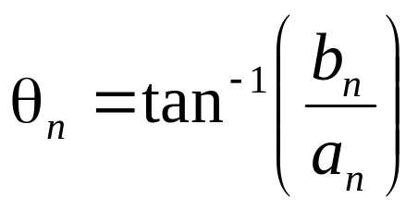
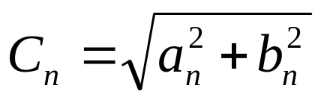
Amplitudes and Phase Angles
harmonic amplitude
phase angle

Slide 25
Fourier Series
Complex Form of the Fourier Series

Slide 26
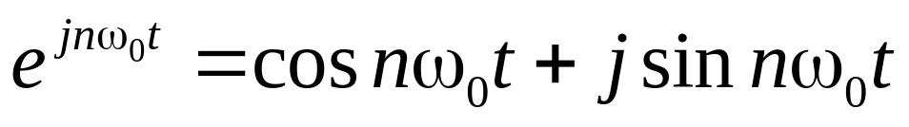



Complex Exponentials

Slide 27





Complex Form of the Fourier Series

Slide 28



Complex Form of the Fourier Series

Slide 29






Complex Form of the Fourier Series

Slide 30








Complex Form of the Fourier Series
If f(t) is real,

Slide 31
Complex Frequency Spectra
|c_{n}|
amplitude
spectrum
ω
phase
spectrum
φ_{n}
ω

Slide 32











Example
f(t)
A
t

Slide 33



Example
A/5
-120π
-80π
-40π
0
40π
80π
120π
-15ω₀
-10ω₀
-5ω₀
5ω₀
10ω₀
15ω₀

Slide 34


Example
A/10
-120π
-80π
-40π
0
40π
80π
120π
-30ω₀
-20ω₀
-10ω₀
10ω₀
20ω₀
30ω₀

Slide 35






Example
f(t)
A
t
0

Slide 36
Fourier Series
Impulse Train

Slide 37


Dirac Delta Function
and
Also called unit impulse function.
t
0

Slide 38


Property
φ(t): Test Function

Slide 39

Impulse Train
t
−3T
−2T
−T
0
T
2T
3T

Slide 40




Fourier Series of the Impulse Train

Slide 41



Complex Form
Fourier Series of the Impulse Train

Slide 42
Fourier Series
Analysis of
Periodic Waveforms

Slide 43


Waveform Symmetry
Even Functions
Odd Functions

Slide 44



Decomposition
Any function f(t) can be expressed as the sum of an even function f_{e}(t) and an odd function f_{o}(t).
Even Part
Odd Part

Slide 45



Example
Even Part
Odd Part

Slide 46


Half-Wave Symmetry
and
−T/2
T/2
T

Slide 47
Quarter-Wave Symmetry
Even Quarter-Wave Symmetry
−T/2
T/2
T
Odd Quarter-Wave Symmetry
−T/2
T/2
T

Slide 48
Hidden Symmetry
The following is a asymmetry periodic function:
A
−T
T
Adding a constant to get symmetry property.
A/2
−T
T
−A/2

Slide 49
Fourier Coefficients of
Symmetrical Waveforms
The use of symmetry properties simplifies the calculation of Fourier coefficients.
  Even Functions
  Odd Functions
  Half-Wave
  Even Quarter-Wave
  Odd Quarter-Wave
  Hidden

Slide 50


Fourier Coefficients of Even Functions

Slide 51


Fourier Coefficients of Even Functions

Slide 52
Fourier Coefficients for Half-Wave Symmetry
and
−T/2
T/2
T
The Fourier series contains only odd harmonics.

Slide 53



Fourier Coefficients for Half-Wave Symmetry
and

Slide 54


Fourier Coefficients for
Even Quarter-Wave Symmetry
−T/2
T/2
T

Slide 55


Fourier Coefficients for
Odd Quarter-Wave Symmetry
−T/2
T/2
T

Slide 56




Example
Even Quarter-Wave Symmetry
1
−T/2
T/2
−T
−T/4
T/4
T
−1

Slide 57

Example
Even Quarter-Wave Symmetry
1
−T/2
T/2
−T
−T/4
T/4
T
−1

Slide 58




Example
Odd Quarter-Wave Symmetry
1
−T/2
T/2
−T
−T/4
T/4
T
−1

Slide 59

Example
Odd Quarter-Wave Symmetry
1
−T/2
T/2
−T
−T/4
T/4
T
−1

Slide 60
Fourier Series
Half-Range Expansions

Slide 61
Non-Periodic Function Representation
τ
A non-periodic function f(t) defined over (0, τ) can be expanded into a Fourier series which is defined only in the interval (0, τ).

Slide 62
Without Considering Symmetry
τ
T
A non-periodic function f(t) defined over (0, τ) can be expanded into a Fourier series which is defined only in the interval (0, τ).

Slide 63
Expansion Into Even Symmetry
τ
T=2τ
A non-periodic function f(t) defined over (0, τ) can be expanded into a Fourier series which is defined only in the interval (0, τ).

Slide 64
Expansion Into Odd Symmetry
T=2τ
τ
A non-periodic function f(t) defined over (0, τ) can be expanded into a Fourier series which is defined only in the interval (0, τ).

Slide 65
Expansion Into Half-Wave Symmetry
τ
T=2τ
A non-periodic function f(t) defined over (0, τ) can be expanded into a Fourier series which is defined only in the interval (0, τ).

Slide 66
Expansion Into
Even Quarter-Wave Symmetry
T/2=2τ
τ
T=4τ
A non-periodic function f(t) defined over (0, τ) can be expanded into a Fourier series which is defined only in the interval (0, τ).

Slide 67
Expansion Into
Odd Quarter-Wave Symmetry
T/2=2τ
T=4τ
τ
A non-periodic function f(t) defined over (0, τ) can be expanded into a Fourier series which is defined only in the interval (0, τ).

Slide 68
Fourier Series
Least Mean-Square Error Approximation

Slide 69



Approximation a function
Use
to represent f(t) on interval −T/2 < t < T/2.
Define
Mean-Square Error

Slide 70

Approximation a function
Show that using S_{k}(t) to represent f(t) has least mean-square property.
Proven by setting ∂E_{k}/∂a_{i} = 0 and ∂E_{k}/∂b_{i} = 0.

Slide 71



Approximation a function

Slide 72

Mean-Square Error

Slide 73

Mean-Square Error

Slide 74

Mean-Square Error

